Slide 1
Concepts of Operating Systems
Atul Kahate

Slide 2
Session 1: Introduction to Operating Systems

Slide 3
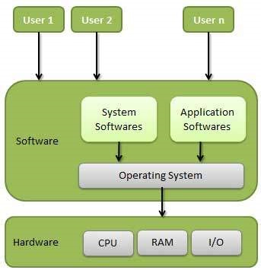
Introduction to OS Concepts
An Operating System (OS) is a program that acts as an intermediary between a user of a computer and the computer hardware.
Operating system goals:
Execute user programs and make solving user problems easier.
Make the computer system convenient to use.
Use the computer hardware in an efficient manner.

Slide 4
Operating System versus Application Software
Linux, Windows, Mac
Word, PowerPoint, Firefox
An operating system is like the entry point into a computer: This is where the computer wakes up.
The operating system is responsible for handling all the aspects pertaining to user programs, process management, memory management, disk management, working with the CPU, etc.
Application software makes use of an operating system for performing various tasks.
An application software allows the user to create presentations, play games, browse the Internet, etc.
An application software is specific, whereas an operating system is generic

Slide 5



Why are High-level Languages Portable?
Program written in C
C compiler for Windows
C compiler for Linux
C compiler for Mac
Execute
Execute
Execute

Slide 6
Why is OS Hardware-dependent?
We have two major choices when writing an OS:
Choice 1: Write the OS in the assembly language of the chosen hardware
Choice 2: Write the OS in a high-level language (such as C or C++ or Java)
Hardware-dependent
Operating System
Hardware-independent
Assembly Language
Hardware Level
(Machine Language)

Slide 7
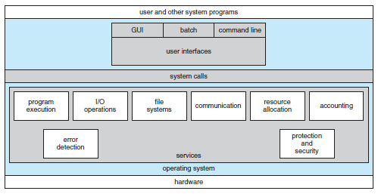
Different Components of an OS

Slide 8
Computer System Structure – 4 Components
Hardware – Provides basic computing resources
CPU, memory, I/O devices
Operating system - Controls and coordinates use of hardware among various applications and users
Application programs – Define the ways in which the system resources are used to solve the computing problems of the users
Word processors, compilers, web browsers, database systems, video games
Users - People, machines, other computers
See next slide for a diagram

Slide 9
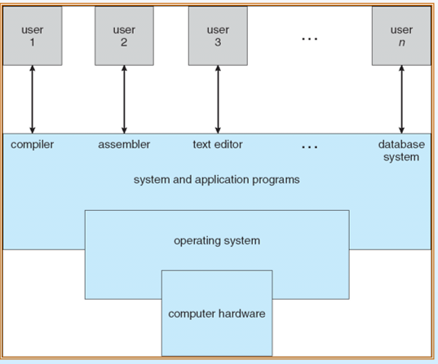
Computer System – Four Components

Slide 10
Examples of OS
Mobile OS: Android, iOS
Embedded Systems OS: Embedded Linux, QNX, VxWorks – Generally work on microwave ovens, TV, DVD, MP3 players, etc – Embedded in ROM
Real-time OS: eCos - Deadline-based work, Controlling machines, Welding robots, etc
Desktop OS: Windows, Linux, Mac – General-purpose OS
Server machine OS: Windows server/Linux server – Need to handle client-requests, load, security

Slide 11
Main Functions of Operating Systems
Provide abstraction to user programs
Managing computer resources
A modern computer consists of one or more processors, some main memory,
disks, printers, a keyboard, a mouse, a display, network interfaces, and various
other input/output devices. If every application programmer
had to understand how all these things work in detail, no code would ever
get written.
Managing these resources in itself is a huge task!

Slide 12
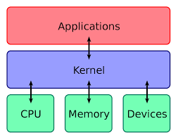
Kernel
“The one program running at all times on the computer” is the kernel.
Everything else is either a system program (ships with the operating system) or an application program.

Slide 13
User Mode and Kernel Mode (Diagram on Next Slide)
Most computers have two modes of operation: kernel mode and user mode.
The operating system runs in kernel mode (also called supervisor mode).
In this mode it has complete access to all the hardware and can execute any instruction the machine is capable of executing.
The rest of the software runs in user mode, in which only a subset of the machine instructions is available.
In particular, those instructions that affect control of the machine or do I/O (Input/Output) are forbidden to user-mode programs.

Slide 14
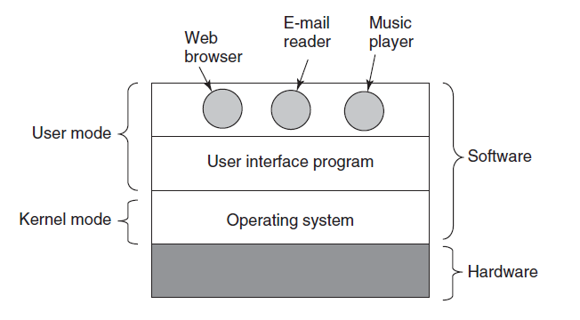
User Mode and Kernel Mode

Slide 15
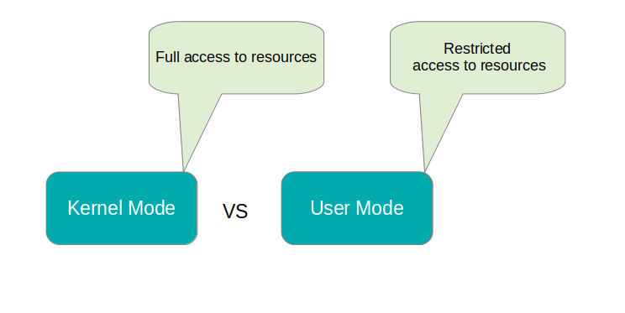
User Mode and Kernel Mode
User mode has restricted access to resources. Example: Text editor, Media player. If a resource such as disk or file is needed, a signal is sent to the CPU via an interrupt to switch to the kernel mode.
Kernel mode (also called as supervisor mode) has full access to memory, I/O, and other resources. Here, CPU has full access to the hardware and can execute any instruction.

Slide 16
User Space and Kernel Space
User space
Area of memory where all the user mode applications execute.
This memory can be “swapped out” when necessary.
Kernel space
Area of memory where all the kernel mode applications execute.
Strictly reserved for kernel background processes and has full hardware access.

Slide 17
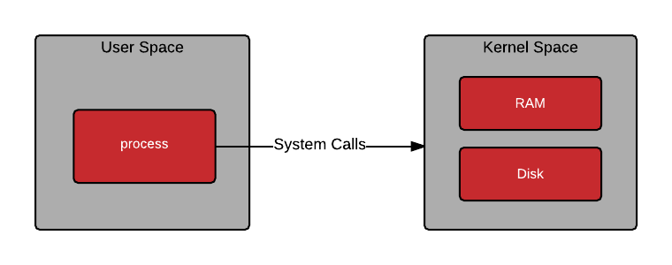
User Space and Kernel Space
User space refers to all of the code in an operating system that lives outside of the kernel. Most Unix-like operating systems (including Linux) come pre-packaged with all kinds of utilities, programming languages, and graphical tools - these are user space applications.
The kernel space provides abstraction for security, hardware, and internal data structures. The open() system call is commonly used to get a file handle in Python, C, Ruby and other languages. You wouldn’t want your program to be able to make bit level changes to the XFS file system, so the kernel provides a system call and handles the drivers.

Slide 18
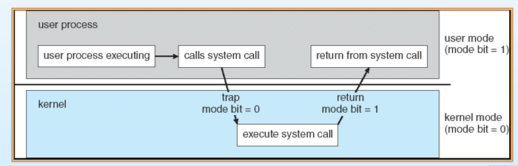
User Mode to Kernel Mode Transition

Slide 19
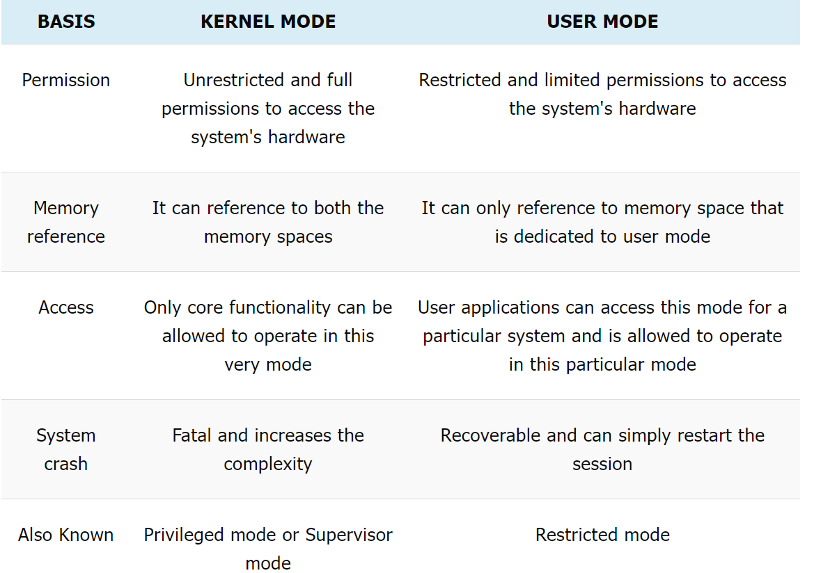
Kernel Mode versus User Mode

Slide 20
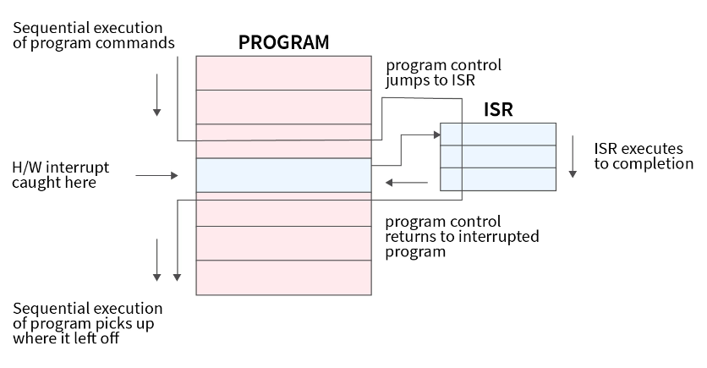
Interrupt Example

Slide 21
Handling interrupts
An interrupt is a signal sent by hardware or software to the processor for processing
The process that runs when an interrupt is generated is the interrupt handler
The CPU saves the state of the ongoing process and shifts its attention to the interrupt generated by giving access to the interrupt handler
This entire process is called interrupt handling
The interrupt handler is also known as Interrupt Service Routine (ISR)
ISR handles the request and sends it to the CPU
When the ISR is complete, the halted process is resumed

Slide 22
How does the CPU know which ISR to call?
Each type of interrupt is assigned a unique interrupt number
The interrupt number and its corresponding instructions set address (or process’s base address) are stored in a vector table known as Interrupt Vector Table (IVT), see next slide
Using the interrupt number and IVT, the CPU comes to know about the base address of the process that is needed to handle the respective interrupt
Now, the control is given to that process to handle the interrupt and this process is known as Interrupt Service Routine (ISR)

Slide 23
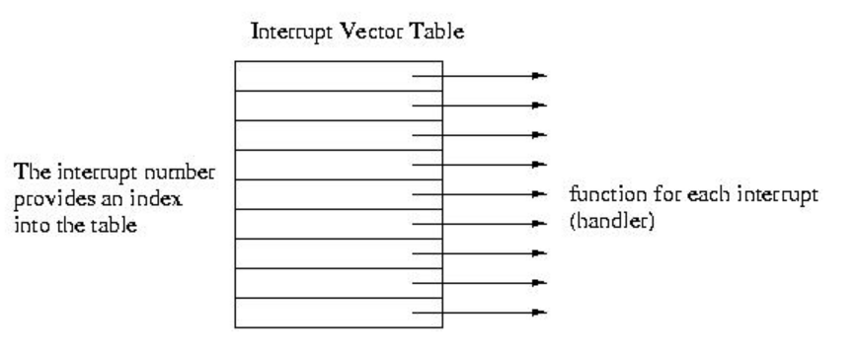
Interrupt Vector Table

Slide 24
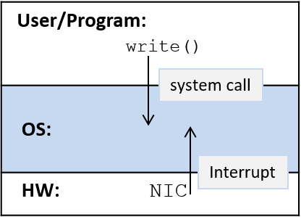
Interrupts and System Calls
Most operating systems are implemented as interrupt-driven systems, meaning that the OS does not run until some entity needs it to do something — the OS is woken up (interrupted from its sleep) to handle a request.
For example, a Network Interface card (NIC) is a hardware interface between a computer and a network. When the NIC receives data over its network connection, it interrupts (or wakes up) the OS to handle the received data.
Requests to the OS also come from user applications when they need access to protected resources. For example, when an application wants to write to a file, it makes a system call to the OS, which wakes up the OS to perform the write on its behalf.

Slide 25
Session 2: Introduction to Linux

Slide 26

Unix
In 1969-1970, Kenneth Thompson, Dennis Ritchie, and others at AT&T Bell Labs began developing a small operating system on a little-used PDP-7 computer.
The operating system was soon christened Unix, a pun on an earlier operating system project called MULTICS.
In 1972-73, Unix was rewritten in C (a visionary and unusual step), which made it portable

Slide 27
Unix Progression
Two dominating versions emerged
Berkley Software Distribution (BSD)
AT&T
Many other mixed versions emerged later
Most of these were proprietary and were maintained by their respective hardware vendor
Example: Sun Solaris
FreeBSD, NetBSD, OpenBSD became open source

Slide 28

Free Software Foundation (FSF)
In 1984, Richard Stallman’s Free Software Foundation (FSF) began the GNU project, a project to create a free version of Unix (See next slide)

Slide 29

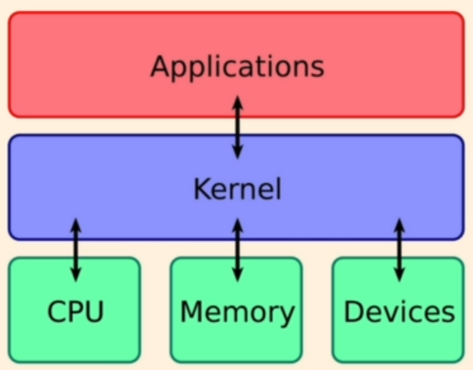
Linux History
A Finnish student Linus Torvalds started a personal project in 1991
He was trying to create a new free operating system kernel, which could work with the FSF material and some BSD components to create a very useful operating system
Memory management, Task scheduling, …
Kernel = Heart of an operating system, which facilitates interactions between hardware and software

Slide 30
Installing Linux – Multiple Options
Use a virtual machine and install a Linux distribution
VMWare or Oracle VirtualBox
Create a dual-boot machine (Windows and Linux)
On a Windows machine, install WSL (Simplest and light-weight)
https://learn.microsoft.com/en-us/windows/wsl/install

Slide 31

Linux Distributions (“Distros”)
In the Linux community, different organizations have combined the available components differently.
Each combination is called a “distribution”, and the organizations that develop distributions are called “distributors”.
Common distributions include Red Hat, Mandrake, SuSE, Caldera, Corel, and Debian.
There are differences between the various distributions, but all distributions are based on the same foundation: the Linux kernel and the GNU glibc libraries.

Slide 32
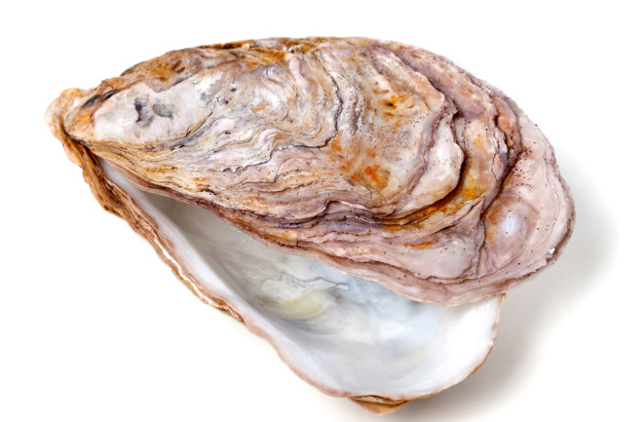
Linux Command Line
Command line = Shell
Shell is a program that takes keyboard commands and passes them to the operating system for execution
Almost all Linux distributions support a shell program called bash
Bash = Bourne Again Shell (because bash replaces sh, the original Unix shell program written by Steve Bourne)
The name shell is given because it is the outer layer of the OS like the shell around an oyster

Slide 33

The Shell Prompt
General format: username@machinename, followed by the current working directory, and a dollar sign
If we have a hash (#) at the end, instead of the dollar, the user has superuser/root privileges

Slide 34
Filesystem Tree
Like Windows, a Unix-like operating system such as Linux organizes its files in what is called a hierarchical directory structure.
This means that they are organized in a tree-like pattern of directories (sometimes called folders in other systems), which may contain files and other directories.
The first directory in the filesystem is called the root directory.
The root directory contains files and subdirectories, which contain more files and subdirectories, and so on.

Slide 35
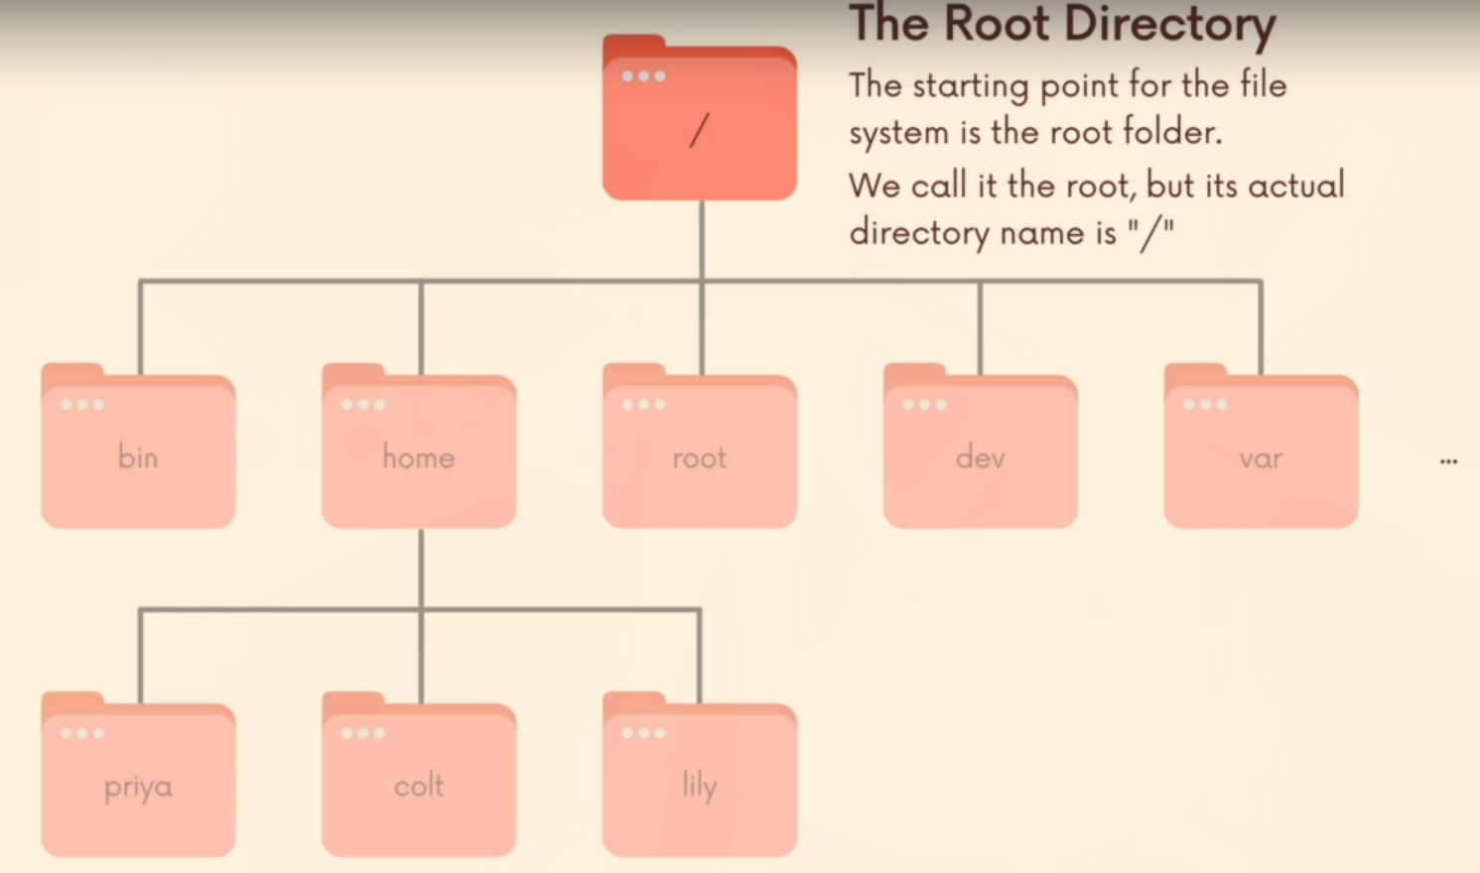
The Root Directory
Confusion!
The real root directory is /
There is also another directory named root within the real root (i.e. /). But this is not the real root.

Slide 36

The Current Directory
The pwd command (print working directory)
When we first log in to our system (or start a terminal emulator session), our current working directory is set to our home directory.
Each user account is given its own home directory, which is the only place the user is allowed to write files when operating as a regular user.

Slide 37
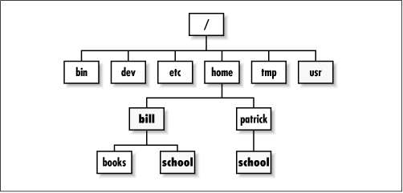
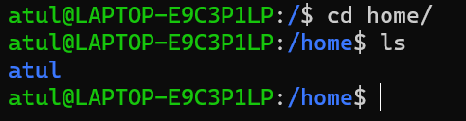
The Home Directory
Each user on the system has a sub-directory inside home

Slide 38
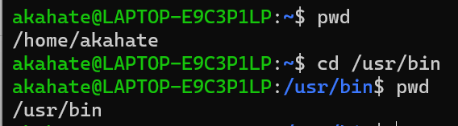
Other Directory Commands
ls: To list the files and directories in the current working directory, we use the ls command
cd: Change directory
Absolute path names: Begins with the root directory and follows the tree branch by branch until the path to the desired directory or file is completed.
For example, there is a directory on your system in which most of your system’s programs are installed. The pathname of that directory is /usr/bin.

Slide 39
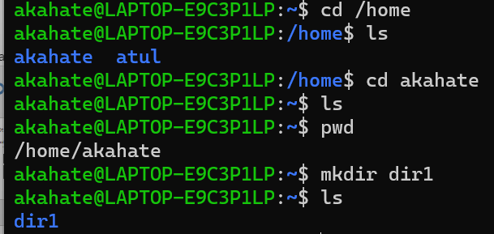
More Directory Commands
mkdir: Create a directory

Slide 40
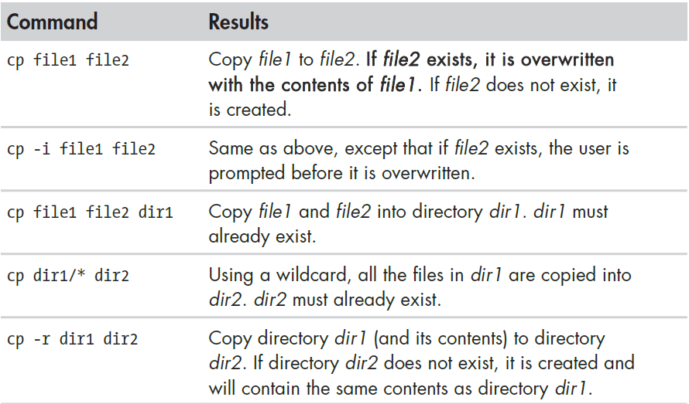
More Directory Commands
cp: Copy files and directories

Slide 41
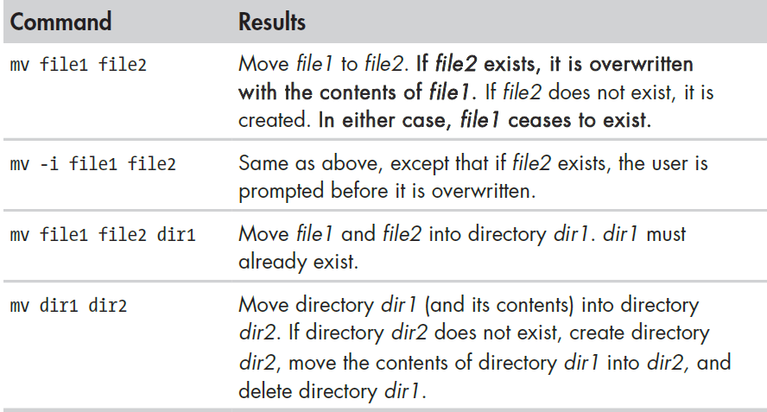
More Directory Commands
mv: Move and rename files

Slide 42
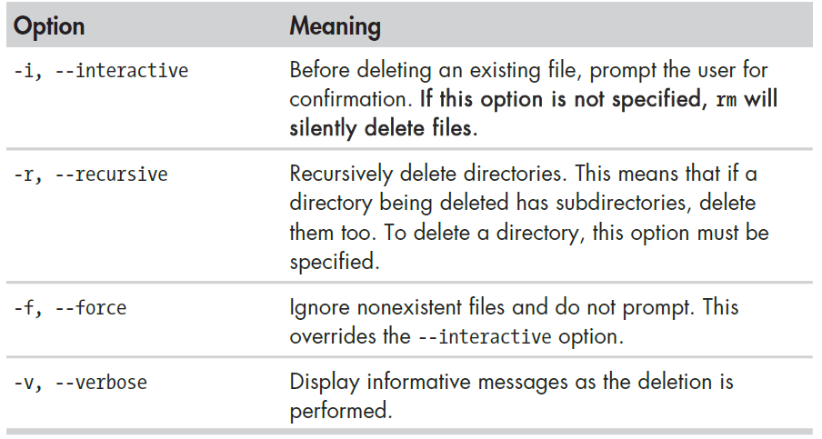
More Directory Commands
rm: Delete files and directories

Slide 43
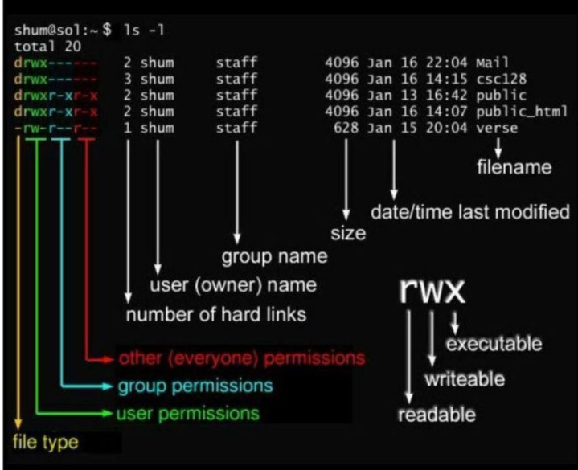

Slide 44
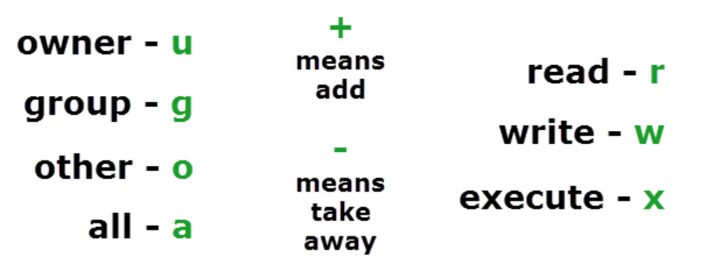
How to Specify Who to Give Permissions To?

Slide 45
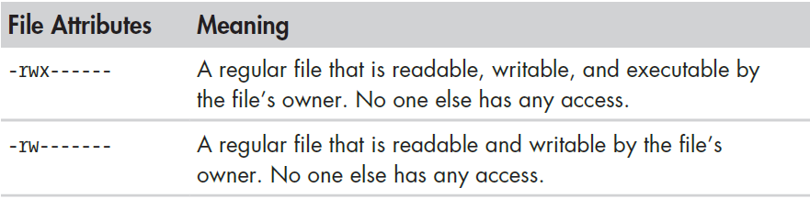
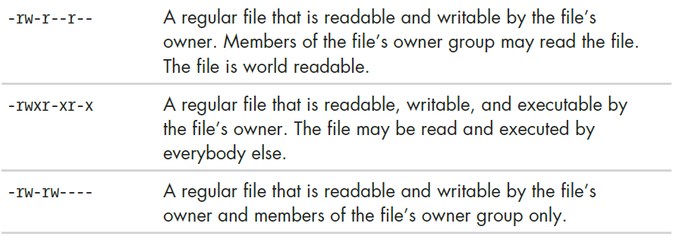
File Permission Examples

Slide 46
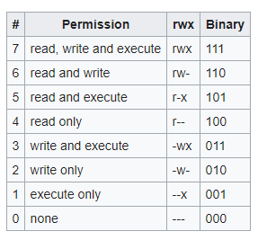
File Permissions in Binary

Slide 47
Understanding Numeric File Permissions
Remember, Read permission = 4, Write permission = 2, Execute permission = 1
Requirement | Character-based permissions | Numeric representation
Give all permissions to all the users | 4 + 2 + 1 for everyone | 777
Give read-write permissions to all the users | 4 + 2 for everyone | 666
Owner should have all the permissions, and the others should have read and execute permissions | 4 + 2 + 1 for the owner, 4 +1 for the others | 755

Slide 48
What is a Shell Script?
In the simplest terms, a shell script is a file containing a series of commands.
The shell reads this file and carries out the commands as though they have been entered directly on the command line.
The shell is distinctive, in that it is both a powerful command-line interface to the system and a scripting language interpreter.

Slide 49
Redirection using Pipe
echo “5/2” | bc
echo “scale=2; 5/2” | bc
echo “scale=10; 5/2” | bc

Slide 50
Redirection using >
name=“Linux Student”
echo $name > out.txt

Slide 51
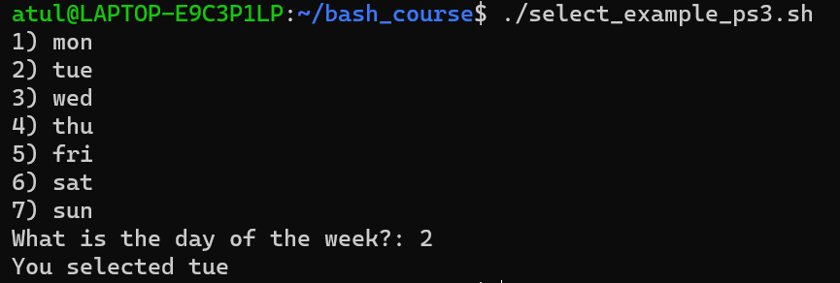
The select Command and the PS3 (Prompt for Select command) Variable
Called ‘Shebang’ or ‘Shabang’ operator, because:
# means sharp (as in C#)
! In comics is used such as Bang!
select_example_ps3.sh
#!/bin/bash
PS3="What is the day of the week?: "
select day in mon tue wed thu fri sat sun;
do
echo "You selected $day"
break
done

Slide 52
Variables
A variable allows us to store useful data under convenient names
User-defined variables
Shell variables

Slide 53
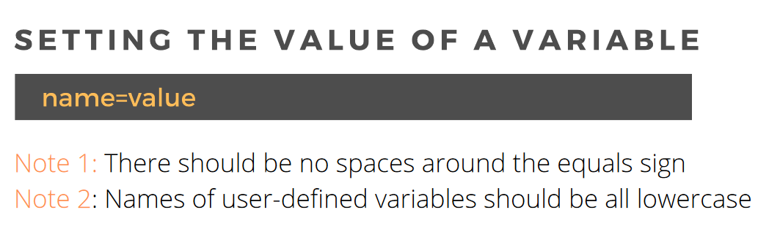
User-defined Variables
Example
INSTITUTE=“ACTS”
echo “Hello $INSTITUTE”

Slide 54
Variable Examples – Note the Difference
#!/bin/bash
COUNT=5
echo “count = $COUNT”
echo We have $COUNT oranges
#!/bin/bash
COUNT=5
COUNT = 6
echo “count = $COUNT”
echo We have $COUNT oranges

Slide 55
Variable Examples – Strings and Spaces
#!/bin/bash
MESSAGE=Hello
echo “I want to say: $MESSAGE”
#!/bin/bash
MESSAGE=Hello there
echo “I want to say: $MESSAGE”
#!/bin/bash
MESSAGE=“Hello there”
echo “I want to say: $MESSAGE”

Slide 56
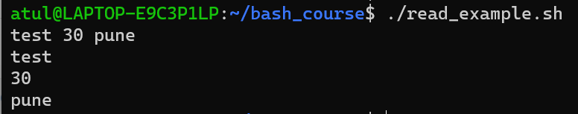
Reading Multiple Inputs in User Variables
read_example.sh
#!/bin/bash
read name age city
echo $name
echo $age
echo $city

Slide 57
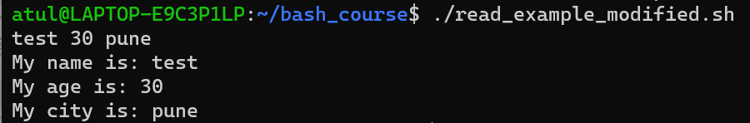
Reading Multiple Inputs in User Variables – Better Formatted
read_example_modified.sh
#!/bin/bash
read name age city
echo "My name is: $name"
echo "My age is: $age"
echo "My city is: $city"

Slide 58
Using echo with read
#!/bin/bash
echo –n “Enter your age:”
read AGE
echo “Your age is $AGE”

Slide 59
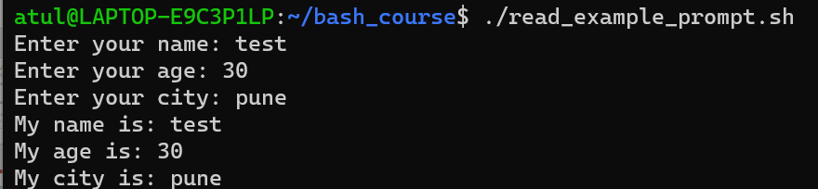
Adding Prompt to the read Command
Other useful options
-t: Timeout in seconds
-s: Secret
read_example_prompt.sh
#!/bin/bash
read -p "Enter your name: " name
read -p "Enter your age: " age
read -p "Enter your city: " city
echo "My name is: $name"
echo "My age is: $age"
echo "My city is: $city"

Slide 60
Session 3: Shell Programming

Slide 61
Conditions – if Statement
#!/bin/sh
a=10
b=20
if [ $a -eq $b ]
then
echo “a is equal to b”
fi
if [ $a -ne $b ]
then
echo “a is not equal to b”
fi

Slide 62
Same Example using if-else
#!/bin/sh
a=10
b=20
if [ $a -eq $b ]
then
echo “a is equal to b”
else
echo “a is not equal to b”
fi

Slide 63
Check If a Number is Positive or Negative
#!/bin/bash
read -p "Enter a number : " n
rem=$(( $n % 2 ))
if [ $rem -eq 0 ]
then
echo "$n is even number"
else
echo "$n is odd number"
fi

Slide 64
Check If a Number if Even or Odd
#!/bin/bash
echo "Enter a number : "
read n
rem=$(( $n % 2 ))
if [ $rem -eq 0 ]
then
echo "$n is even number"
else
echo "$n is odd number"
fi

Slide 65
Calculate Average using Bash Calculator
#!/bin/bash
read -p "Enter marks in subject 1: " marks1
read -p "Enter marks in subject 2: " marks2
read -p "Enter marks in subject 3: " marks3
total=$(( $marks1 + $marks2 + $marks3 ))
echo "Total marks: $total"
avg=$( echo "scale=4; $total / 3" | bc )
echo "Average marks: $avg"

Slide 66
for Loop
#!/bin/bash
# basic for command
for test in Alabama Alaska Arizona Arkansas California Colorado
do
echo The next state is $test
done

Slide 67
C-Style for Loop
#!/bin/bash
# testing the C-style for loop – double brackets are needed
for (( i=1; i <= 10; i++ ))
do
echo "The next number is $i"
done

Slide 68
while Command
#!/bin/bash
# while command test
var1=10
while [ $var1 -gt 0 ]
do
echo $var1
var1=$[ $var1 - 1 ]
done

Slide 69
Table of a Number
#!/bin/bash
read -p "Enter The Number for which you want to Print Table: " n
i=1
while [ $i -ne 11 ]; do
table=$((i * n))
echo "$table"
i=$((i + 1))
done

Slide 70
until Example
#!/bin/bash
# using the until command
var1=100
until [ $var1 -eq 0 ]
do
echo $var1
var1=$[ $var1 - 25 ]
done

Slide 71
break Example
#!/bin/bash
# breaking out of a for loop
for var1 in 1 2 3 4 5 6 7 8 9 10
do
if [ $var1 -eq 5 ]
then
break
fi
echo "Iteration number: $var1"
done
echo "The for loop is completed"

Slide 72
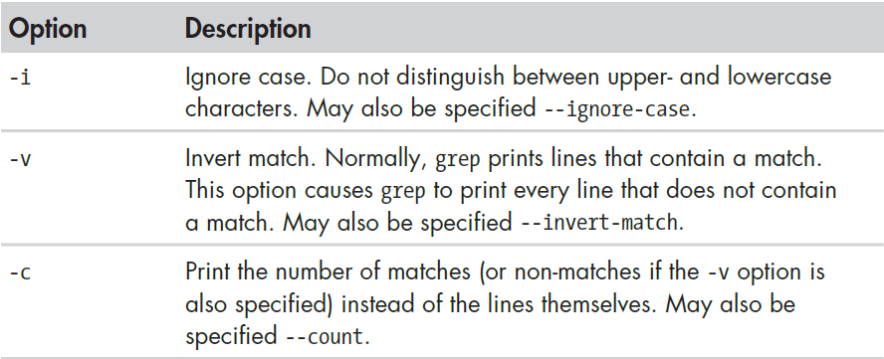
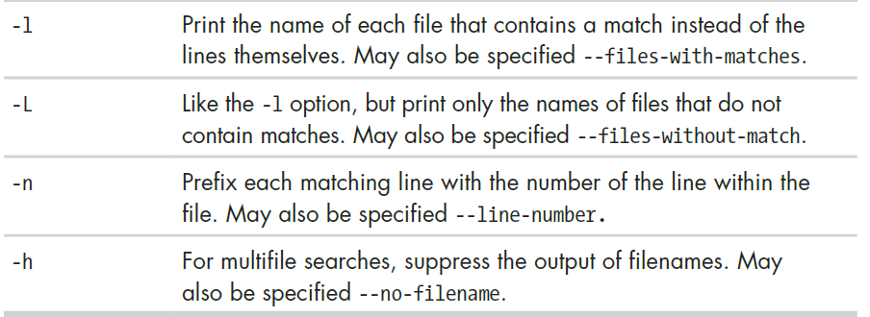
grep – Searching through text
grep searches text files for the occurrence of a specified regular expression and outputs any line containing a match to standard output.
Has many options
grep PATTERN file
e.g. grep “tiger” animals.txt

Slide 73
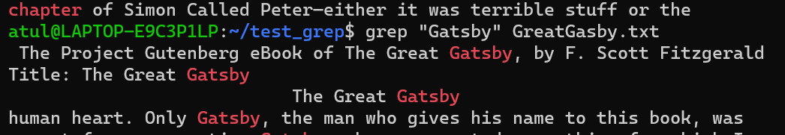
Another Example
Create a test_grep directory in home/<user name> directory (e.g. /home/atul/test_grep
Create a file GreatGatsby.txt in home/atul/test_grep directory (Available at https://www.gutenberg.org/cache/epub/64317/pg64317.txt)
grep “chapter” GreatGatsby.txt
grep “Gatsby” GreatGatsby.txt
… and many more lines

Slide 74
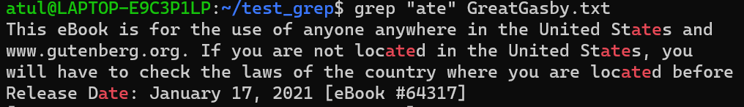
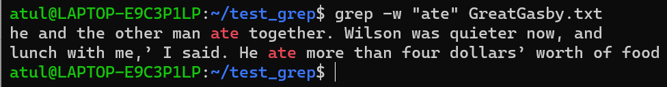
More Examples
grep “ate” GreatGatsby.txt
Shows all occurrences of the word ate, including text inside other words
To restrict to whole words only:
grep -w “ate” GreatGatsby.txt

Slide 75
Sessions 4-6: Process Management

Slide 76
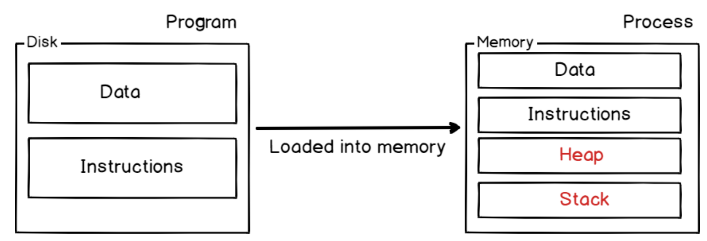
Program and Process

Slide 77
Process Concept
A process is a program in execution. It is a unit of work within the system. Program is a passive entity, process is an active entity.
Process needs resources to accomplish its task
CPU, memory, I/O, files
Initialization data
Process termination requires reclaim of any reusable resources
Single-threaded process has one Program Counter (PC) specifying location of next instruction to execute
Process executes instructions sequentially, one at a time, until completion
Multi-threaded process has one program counter per thread
Typically system has many processes, some user, some operating system running concurrently on one or more CPUs
Concurrency by multiplexing the CPUs among the processes / threads

Slide 78
Process Management
Creating and deleting both user and system processes
Suspending and resuming processes
Providing mechanisms for process synchronization
Providing mechanisms for process communication
Providing mechanisms for deadlock handling

Slide 79
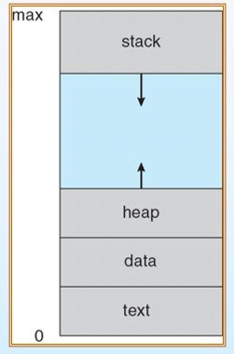
Process in Memory
A process includes:
program counter
stack
data section

Slide 80
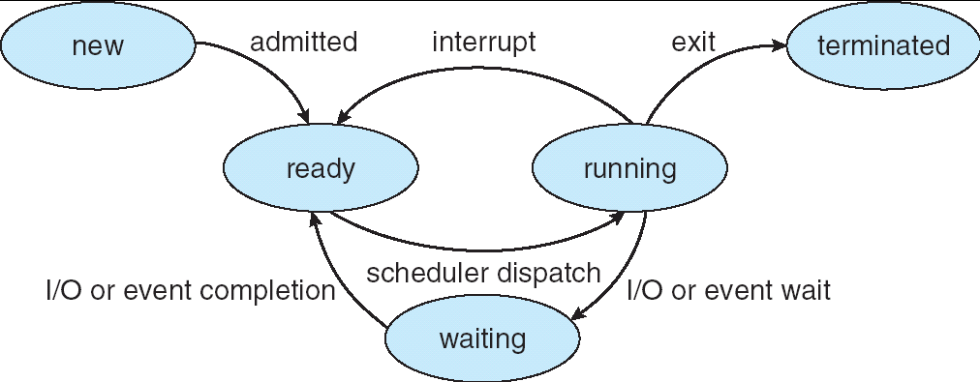
Process States
new: The process is being created
running: Instructions are being executed
waiting: The process is waiting for some event to occur
ready: The process is waiting to be assigned to a processor
terminated: The process has finished execution

Slide 81
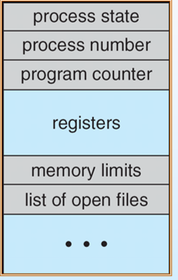
Process Control Block (PCB)

Slide 82
Process Scheduling
Process scheduling is the activity of the process manager that handles the removal of the running process from the CPU and the selection of another process on the basis of a particular strategy.
Process scheduling is an essential part of a Multiprogramming operating system.
Such operating systems allow more than one process to be loaded into the executable memory at a time and loaded processes share the CPU one after the other using time multiplexing.

Slide 83
Scheduling Queues
Scheduling queues refers to queues of processes or devices.
When a process enters into the system, then this process is put into a scheduling queue (also called as job queue).
This queue consists of all processes in the system.
The operating system also maintains other queues such as device queue. Device queue is a queue for which multiple processes are waiting for a particular I/O device. Each device has its own device queue.

Slide 84
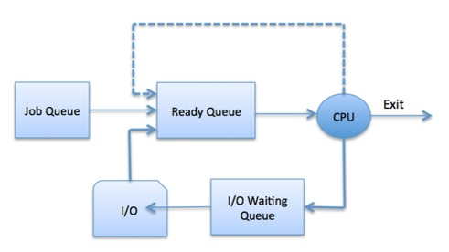
Process Scheduling

Slide 85
Scheduling Queues
A newly arrived process is put in the ready queue. Processes wait in ready queue for the CPU. Once the CPU is assigned to a process, then the selected process will execute.
While executing the process, any one of the following events can occur.
The process could issue an I/O request and then it would be placed in an I/O queue.
The process could create new sub process and will wait for its termination.
The process could be removed forcibly from the CPU, as a result of interrupt and put back in the ready queue.

Slide 86
Scheduler Types
A scheduler is a special type of system software which handles process scheduling in various ways. Its main task is to select the jobs to be submitted into the system and to decide which process to run.
Schedulers are of three types
Long Term Scheduler
Short Term Scheduler
Medium Term Scheduler

Slide 87
Long Term Scheduler
It is also called job scheduler.
Long term scheduler determines which programs are admitted to the system for processing.
Long term/Job scheduler selects processes from the queue and loads them into memory for execution.
Process loads into the memory for CPU scheduling.
The primary objective of the job scheduler is to provide a balanced mix of jobs, such as I/O bound and processor bound.
It also controls the degree of multiprogramming (Number of new processes and departing processes).

Slide 88
Short Term Scheduler
It is also called CPU scheduler.
Main objective is increasing system performance in accordance with the chosen set of criteria. It is the change of ready state to running state of the process.
CPU scheduler selects process among the processes that are ready to execute and allocates CPU to one of them.
Short term scheduler also known as dispatcher, executes most frequently and makes the fine grained decision of which process to execute next.
Short term scheduler is faster than long term scheduler.

Slide 89
Medium Term Scheduler
Medium term scheduling is part of the swapping (Explained below).
It removes the processes from the memory.
It reduces the degree of multiprogramming.
The medium term scheduler is in-charge of handling the swapped out-processes.
Swapping: Running process may become suspended if it makes an I/O request. Suspended processes cannot make any progress towards completion. In this condition, to remove the process from memory and make space for other process, the suspended process is moved to the secondary storage. This process is called swapping, and the process is said to be swapped out or rolled out. (See next slide)

Slide 90
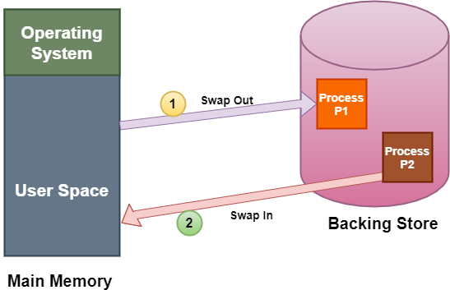
Swapping

Slide 91
CPU Scheduling (i.e. Short Term Scheduling)
Resources: the things operated on by processes.
Resources ranges from CPU time to disk space, to I/O channel time.
Resources fall into two classes:
Preemptive: OS can take resource away. Use it for something else, and then give it back later.
Examples: processor
Non-preemptive: Once given, it cannot be reused until the process gives it back.
Examples: file, terminal
Anything is preemptive if it can be saved and restored.

Slide 92
Criteria for a Good CPU Scheduling Algorithm
1. Fairness: Every process gets its fair share of CPU (i.e. time slice).
2. Efficiency (utilization): Keep CPU busy.
3. Response time: Minimize response time for interactive users.
4. Throughput: Maximize jobs per hour.
5. Minimize overhead (Context switch).

Slide 93
Scheduling Algorithms
First-Come First-Served (FCFS)
Round Robin (RR)
Priority
Shortest Job First (SJF) / Earliest Deadline First (EDF)

Slide 94
Preemptive and Non-preemptive Algorithms
Preemptive algorithm
An algorithm that can be interrupted by an operating system if there is a need to do so
This means that if a process is a part of a preemptive algorithm, then while it is running, it can be interrupted
Non-preemptive algorithm
An algorithm that cannot be interrupted by an operating system even if there is a need to do so
This means that if a process is a part of a non-preemptive algorithm, then while it is running, it cannot be interrupted

Slide 95
First Come First Serve (FCFS)
Also called First In First Out (FIFO)
FCFS is simplest of CPU Scheduling Algorithm which executes process that comes first.
It is non-preemptive algorithm.
Process that comes in ready queue first gets to be executed by the CPU first, then second one, then third one, and so on.
The arrival time of processes is deciding factor here.

Slide 96
Measuring Process Timings
Arrival time: Time when the process arrived in the process queue
Burst time: The CPU time used by the process
Completion time: The time at which the process got completed
Turn around time: The time between its turnaround -
Waiting time: The time for which the process needed to wait, due to lack of CPU attention
Turn Around Time = Completion Time - Arrival Time
Waiting Time = Turnaround time - Burst Time

Slide 97
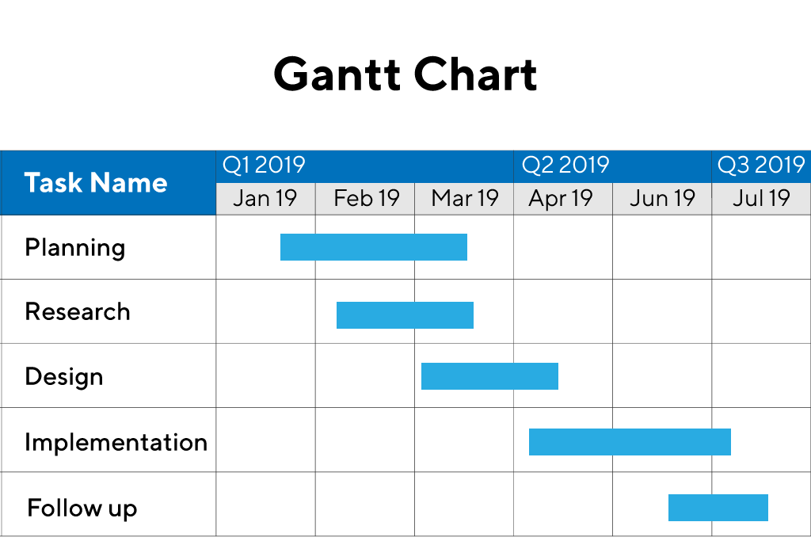
Gantt Chart Concept
A Gantt chart is commonly used in project management
One of the most popular and useful ways of showing activities (tasks or events) displayed against time
Each activity is represented by a bar; the position and length of the bar reflects the start date, duration and end date of the activity
It is used in showing processes during CPU scheduling activities

Slide 98
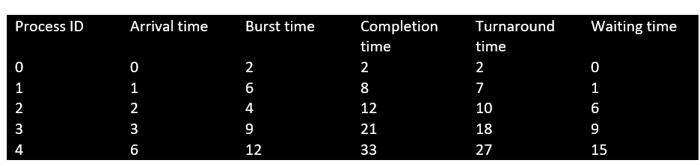
Example
Example: There are 5 processes with process ID P0, P1, P2, P3 and P4. P0 arrives at time 0, P1 at time 1, P2 at time 2, P3 arrives at time 3 and Process P4 arrives at time 4 in the ready queue.
Turn Around Time = Completion Time - Arrival Time
Waiting Time = Turnaround time - Burst Time

Slide 99
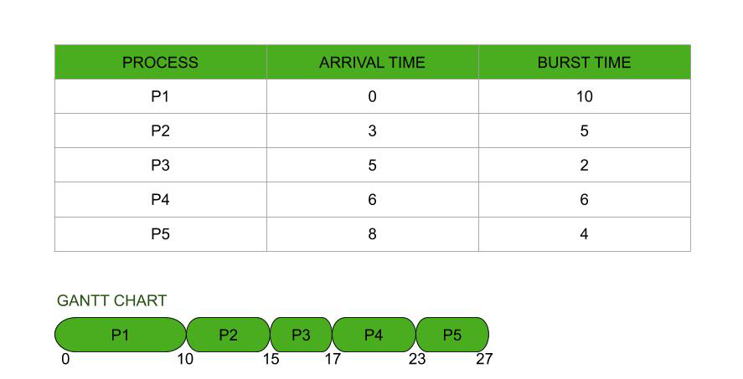
FCFS Example

Slide 100
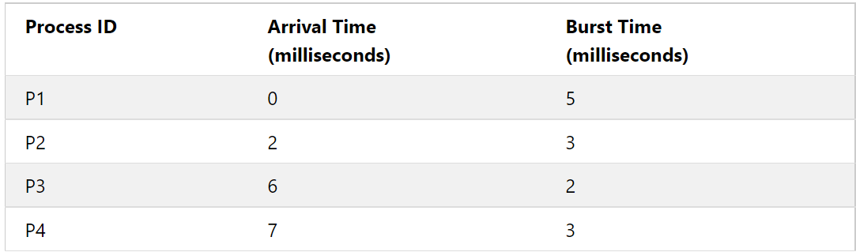
FCFS Problem
Suppose there are four processes with process ID's P1, P2, P3, and P4 and they enter into the CPU as follows:
Calculate total and average turnaround time and waiting time.

Slide 101
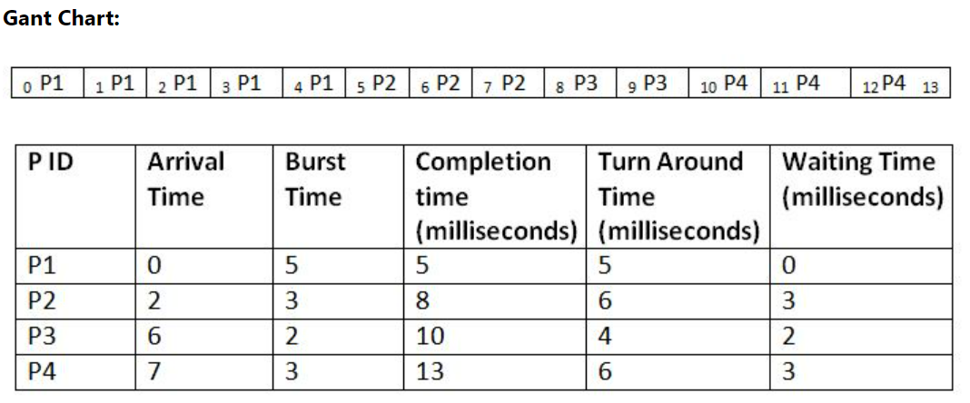
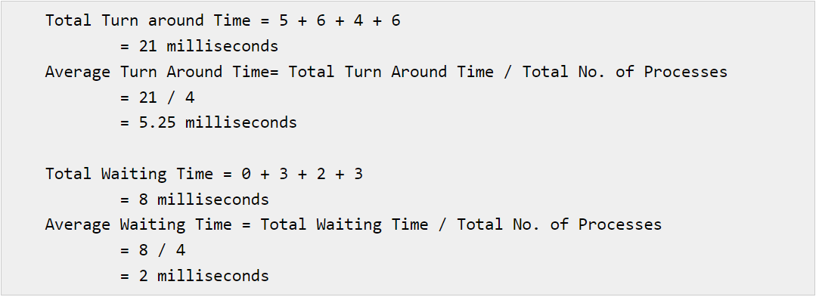
Solution

Slide 102
Round Robin (RR)
The Round Robin (RR) scheduling algorithm is a preemptive scheduling algorithm.
It uses concept of time slice.
Process at the beginning of ready queue gets chance to be executed first but only for span of one time slice.
As new and more processes get added to ready queue, ongoing process gets preempted and gets added to end of ready queue.
Next process gets the chance, again for span of one time slice.
This algorithm is designed for time-sharing systems.

Slide 103
Round Robin (RR) – Key Points
If the process has a CPU burst of less than time slice, then as soon as it is over, the CPU resources are released voluntarily. The next process in the ready queue occupies the CPU.
If the CPU burst is larger than the slice, the timer will go off and the process is preempted, its state is saved by context switching and process is put at the end of the ready queue. After this, the next process in the ready queue takes over.

Slide 104
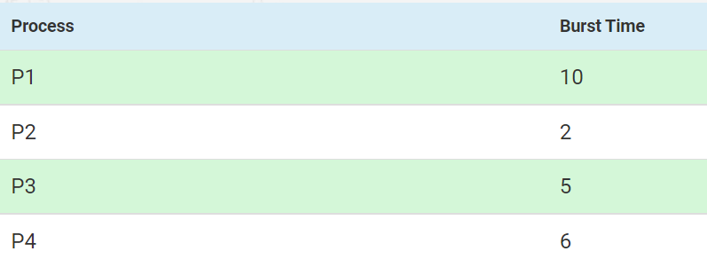
Round Robin (RR) Example
Consider 4 processes where time slice is 3
Calculate average waiting time

Slide 105
Explanation
P1 is executed for 3ms. Then P2 is executed. As, P2 is only 2ms long, So after 2ms, the next process occupies the CPU.
P3 then is executed for 3ms. So, P3 still needs 2ms. Then, P4 is executed for 3ms. P4 still needs 3ms.
P1 is again executed for 3ms. P1 still needs 4ms.
P3 is executed for 2ms. Then, P4 is executed for 3ms.
Now remaining process is P1 only. It executes for 3ms. After that, Since P2, P3 and P4 are already finished, P1 is executed again for remaining time (1ms).

Slide 106

Gantt Chart
P1 has utilized two 3ms time slices earlier, so we subtract 3 twice from its last start time
Average waiting time for P1 = 19-(3+3) = 13ms
Average Waiting time for P2 = 3ms
Average Waiting time for P3 = 14-3 = 11ms
Average Waiting time for P4 = 16-3 = 13ms
Total average waiting time = (13+3+11+13)/4 = 10ms
Both P3 and P4 have utilized one time slice each, earlier, so we subtract 3 from them

Slide 107
Round Robin – Summary
Advantage:
It does not cause starvation, as all the processes get equal CPU time slices.
Disadvantages:
There is an overhead of context switching.
Too small time slices cause overhead and slower execution of processes. So, time slices must be large with respect to the context switch time.

Slide 108
Priority Scheduling
Priority scheduling is a non-preemptive algorithm and one of the most common scheduling algorithms in batch systems.
The process priorities are compared (low priority number means higher priority, i.e. priority 0 is the highest priority).
These steps are repeated.

Slide 109


Priority Scheduling Example
Consider the following and implement priority scheduling
Gantt chart

Slide 110

Priority Scheduling – Problem
Perform priority scheduling for the following processes:

Slide 111

Solution
We can draw a Gantt chart

Slide 112

Explanation

Slide 113
Priority Scheduling – Points
A process having lower priority can be indefinitely blocked or starved.
To prevent this, we do aging, where the priority of the process is increased as it waits in the queue.
So, a process which has been in a queue for a long time will reach high priority, and hence it won’t be starved.

Slide 114
Earliest Deadline First (EDF) Scheduling
Earliest Deadline First (EDF) is an optimal dynamic priority scheduling algorithm used in real-time systems.
EDF uses priorities to the jobs for scheduling.
It assigns priorities to the task according to the absolute deadline.
The task whose deadline is closest gets the highest priority.
The priorities are assigned and changed in a dynamic fashion.

Slide 115

Linux and Process-related Commands
To find out which processes are running on Linux, we can use the ps command
To see a tree of the processes, we can use pstree

Slide 116
Process Creation Commands – fork, waitpid, and exec
It is a clone operation.
Here, the current process is taken and cloned.
So, now we have a parent process and a child process with two different process IDs.
Everything (sack, heap, file descriptors etc) are copied from the parent process to the child process. The two are independent processes now.
fork
Consider the shell. It reads a command from the terminal, forks off a child process, waits for the child process to execute the command, and then reads the next command when the child terminates.
To wait for the child to finish, the parent executes a waitpid system call.
waitpid
The child process must execute the command typed by the user. For this, the exec call is used. The entire core image of the process is replaced by the file named in its first parameter (see next slide).
exec

Slide 117

Illustration of fork, waitpid and exec

Slide 118

A Highly Simplified Shell

Slide 119
Testing fork, waitpid and exec
Install gcc in the Linux machine
sudo apt install gcc
We will create three files
fork_test.c
getpid.c
exec.c
To compile and execute (Shown for one case)
gcc fork_test.c
./a.out

Slide 120
fork_test.c
#include <stdio.h>
#include <unistd.h>
/* This program forks and and the prints whether the process is
* - the child (the return value of fork() is 0), or
* - the parent (the return value of fork() is not zero)
*
* When this was run 100 times on the computer the author is
* on, only twice did the parent process execute before the
* child process executed.
*
* Note, if you juxtapose two strings, the compiler automatically
* concatenates the two, e.g., "Hello " "world!"
*/
int main( void ) {
char *argv[3] = {"Command-line", ".", NULL};
int pid = fork();
if ( pid == 0 ) {
execvp( "find", argv );
}
/* Put the parent to sleep for 2 seconds--let the child finished executing */
wait( 2 );
printf( "Finished executing the parent process\n"
" - the child won't get here--you will only see this once\n" );
return 0;
}

Slide 121
getpid.c
#include <stdio.h>
#include <unistd.h>
/* This program demonstrates that the use of the getpid() function.
*
* When this was run 100 times on the computer the author is
* on, only twice did the parent process execute before the
* child process executed.
*
* Note, if you juxtapose two strings, the compiler automatically
* concatenates the two, e.g., "Hello " "world!"
*
* The return value of fork() is actually pid_t ('pid' 't'ype).
* When it is assigned to 'int pid', if the type is different, there
* is an implicit cast; however, when we print the return value
* of getpid(), it is necessary to explicitly cast it as an
* integer.
*
* The type 'pid_t' is defined in the library header <sys/types.h>
*/
int main( void ) {
printf( "The process identifier (pid) of the parent process is %d\n", (int)getpid() );
int pid = fork();
if ( pid == 0 ) {
printf( "After the fork, the process identifier (pid) "
"of the child is %d\n", (int)getpid() );
} else {
printf( "After the fork, the process identifier (pid) "
"of the parent is still %d\n - fork() returned %d\n",
(int)getpid(), pid );
}
return 0;
}

Slide 122
exec.c
#include <stdio.h>
#include <unistd.h>
#include <sys/wait.h>
#include <sys/types.h>
/* This program forks and and the prints whether the process is
* - the child (the return value of fork() is 0), or
* - the parent (the return value of fork() is not zero)
*
* When this was run 100 times on the computer the author is
* on, only twice did the parent process execute before the
* child process executed.
*
* Note, if you juxtapose two strings, the compiler automatically
* concatenates the two, e.g., "Hello " "world!"
*/
int main( void ) {
char *argv[3] = {"Command-line", ".", NULL};
int pid = fork();
if ( pid == 0 ) {
execvp( "find", argv );
}
/* Put the parent to sleep --let the child finish executing */
wait( NULL );
printf( "Finished executing the parent process\n"
" - the child won't get here--you will only see this once\n" );
return 0;
}

Slide 123

Sample Execution

Slide 124
Zombie Process
If a process exits and its parent has not yet waited for it, the process enters a kind of suspended animation called the zombie state—the living dead.
When the parent finally waits for it, the process terminates.
Let us write a C program for this (zombie.c)
The child finishes its execution using exit() system call while the parent sleeps for 50 seconds, hence doesn’t call wait() and the child process’s entry still exists in the process table.

Slide 125
zombie.c
// A C program to demonstrate Zombie Process.
// Child becomes Zombie as parent is sleeping
// when child process exits.
#include <stdlib.h>
#include <sys/types.h>
#include <unistd.h>
int main()
{
// Fork returns process id
// in parent process
pid_t child_pid = fork();
// Parent process
if (child_pid > 0)
sleep(50);
// Child process
else
exit(0);
return 0;
}

Slide 126
Orphan Process
A process whose parent process no more exists i.e. has either finished or terminated without waiting for its child process to terminate is called an orphan process.
Let us write a C program.
Here, the parent finishes execution and exits while the child process is still executing and is called an orphan process now.
However, the orphan process is soon adopted by init process, once its parent process dies.

Slide 127
orphan.c
// A C program to demonstrate Orphan Process.
// Parent process finishes execution while the
// child process is running. The child process
// becomes orphan.
#include<stdio.h>
#include <sys/types.h>
#include <unistd.h>
#include <stdlib.h>
int main()
{
// Create a child process
int pid = fork();
if (pid > 0) {
printf("in parent process");
exit (0);
}
// Note that pid is 0 in child process
// and negative if fork() fails
else if (pid == 0)
{
sleep(30);
printf("in child process");
}
return 0;
}

Slide 128
Session 7: Signals and Threads

Slide 129

Signals
Signals are used by Linux processes to communicate with one another.
Process A
Signal
Process B

Slide 130
Signal Example
Simple example of a signal:
Run the following command on the shell prompt: sleep 100
The terminal will not do anything for 100 seconds now
But we can press Ctrl+C to break it
This sends a SIGINT signal to the sleeping process and stops it

Slide 131
Signal Handler
A signal handler is special function (defined in the software program code and registered with the kernel) that gets executed when a particular signal arrives.
This causes the interruption of current executing process and all the current registers are also saved.
The interrupted process resumes once the signal handler returns.

Slide 132
C Program: signal_example.c
#include <stdio.h>
#include <stdlib.h>
#include <signal.h>
#include <unistd.h>
void sig_handler(int sig_num)
{
if(sig_num == SIGINT)
{
printf("\n Caught the SIGINT signal\n");
}
else
{
printf("\n Caught the signal number [%d]\n", sig_num);
}
// Do all the necessary clean-up work here
exit(sig_num);
}
int main(void)
{
//Register signal handler through the signal() function
signal(SIGINT, sig_handler);
while(1)
{
//simulate a delay -- as if the program is doing some other stuff
sleep(1);
}
return 0;
}

Slide 133

Running the Program
You will have to Ctrl+C to end it

Slide 134

Explanation
We can see that the program was executed and then the signal SIGINT is passed to it by pressing the Ctrl+c key combination. As can be seen from the debug print in the output, the signal handler was executed as soon as the signal SIGINT was delivered to the process.

Slide 135
Absence of Signal Function: signal_example_endless.c
#include <stdio.h>
#include <stdlib.h>
#include <signal.h>
#include <unistd.h>
int main(void)
{
//Register signal handler through the signal() function
signal(SIGINT, SIG_IGN);
while(1)
{
//simulate a delay -- as if the program is doing some other stuff
sleep(1);
}
return 0;
}
There is no signal handler function now as the second argument to the signal function is replaced with SIG_IGN

Slide 136

Running the Example
You will have to press Ctrl+Z now
It sends SIGSTP signal to the current foreground application. This effectively puts the program in the background. In English, it basically PAUSES the application. So, in the ps command, we should see the process still running!

Slide 137

Now Killing the Process by sending a SIGTERM Signal through the kill Command

Slide 138
Processes and Threads

Slide 139
Processes and Threads
A thread is a lightweight process.
A process can do more than one unit of work concurrently by creating one or more threads. These threads, being lightweight, can be spawned quickly.
We can identify the process and its thread in Linux using the ps -eLf command:
PID: Unique process identifier
LWP: Unique thread identifier inside a process
NLWP: Number of threads for a given process

Slide 140

Single-Threaded and Multi-Threaded Processes

Slide 141

Multithreaded Server

Slide 142

Example

Slide 143

The clone Function
We can use the clone function to create a new process as well as a thread
Of course, we can use the fork function to clone a process
A flag decides what will get created

Slide 144
Threads in Linux: clone.c
#define _GNU_SOURCE
#include <stdio.h>
#include <unistd.h>
#include <stdlib.h>
#include <sched.h>
#include <signal.h>
#define STACK 8192
int do_something(){
printf("Child pid : %d\n", getpid());
return 0;
}
int main() {
void *stack = malloc(STACK); // Stack for new process
if(!stack) {
perror("Malloc Failed");
exit(0);
}
if( clone( &do_something, (char *)stack + STACK, CLONE_VM, 0) < 0 ){
perror("Clone Failed");
exit(0);
}
printf("Parent pid : %d\n", getpid());
sleep(1); // Add sleep so we can she both processes output
free(stack);
return 0;
}

Slide 145

Running the Example

Slide 146

User and Kernel Threads
User threads are supported above the kernel
Kernel threads are supported and managed directly by the operating system
User threads cannot run on their own, so they need kernel-level threads to execute
So, for a user-level thread to make progress, the user program has to have its scheduler take a user-level thread and run it on a kernel-level thread
Mapping user threads to kernel threads:
Many-to-One Model
One-to-One Model
Many-to-Many Model

Slide 147

Many-to-One Model
The many-to-one model maps all user threads to only one kernel thread
The process can run only one user thread at a time, as there is only one kernel thread associated with the process

Slide 148

One-to-One Model
The one-to-one model maps each user thread to a kernel thread
Better concurrency
Allows multiple threads to run in parallel on multiprocessors
The only drawback to this model is that creating a user thread requires creating the corresponding kernel thread

Slide 149

Many-to-Many Model
The many-to-many model multiplexes many user-level threads to a smaller or equal number of kernel threads
A pool of kernel threads is created
User threads are allocated one or more kerel threads from this pool

Slide 150

Using the Posix Thread (pthread) function – pthread.c
#include <stdio.h>
#include <stdlib.h>
#include <unistd.h> //Header file for sleep().
#include <pthread.h>
// A normal C function that is executed as a thread
// when its name is specified in pthread_create()
void *myThreadCall(void *vargp)
{
sleep(1);
printf("Printing CDAC from Thread \n");
return NULL;
}
int main()
{
pthread_t thread_id;
printf("Before Thread\n");
pthread_create(&thread_id, NULL, myThreadCall, NULL);
pthread_join(thread_id, NULL);
printf("After Thread\n");
exit(0);
}
Note: We might have to do gcc pthread.c –lpthread if we get linking errors.

Slide 151
Code Explanation
In main(), we declare a variable called thread_id, which is of type pthread_t, which is an integer used to identify the thread in the system. After declaring thread_id, we call pthread_create() function to create a thread.
pthread_create() takes 4 arguments.
The first argument is a pointer to thread_id which is set by this function.
The second argument specifies attributes. If the value is NULL, then default attributes shall be used.
The third argument is name of function to be executed for the thread to be created.
The fourth argument is used to pass arguments to the function, myThreadFun.
The pthread_join() function for threads is the equivalent of wait() for processes. A call to pthread_join blocks the calling thread until the thread with identifier equal to the first argument terminates.

Slide 152
Multithreading Example – multithread.c
#include <stdio.h>
#include <stdlib.h>
#include <unistd.h>
#include <pthread.h>
// Let us create a global variable to change it in threads
int g = 0;
// The function to be executed by all threads
void *myThreadFCall(void *vargp)
{
// Store the value argument passed to this thread
int *myid = (int *)vargp;
// Let us create a static variable to observe its changes
static int s = 0;
// Change static and global variables
++s; ++g;
// Print the argument, static and global variables
printf("Thread ID: %d, Static: %d, Global: %d\n", *myid, ++s, ++g);
}
int main()
{
int i;
pthread_t tid;
// Let us create three threads
for (i = 0; i < 3; i++)
pthread_create(&tid, NULL, myThreadCall, (void *)&tid);
pthread_exit(NULL);
return 0;
}

Slide 153
Thread Synchronization
When we have two or more threads sharing resources, updates to these shared resources by one thread can cause problems for the other thread(s) – See next slide
The overall processing/output may not remain stable
Let us understand this with a series of programs
thread_1.c: Simple program using a single thread (i.e. no multithreading)
thread_2.c: Multi-threading is used, No thread synchronization is done, Output is inconsistent
thread_3.c: Multi-threading is used, Thread synchronization is done using mutual exclusion (mutex), Output is consistent

Slide 154

Thread Synchronization Problem – Example

Slide 155

Thread Synchronization Problem – Solution

Slide 156

thread_1.c (Single-threaded)
#include <stdio.h>
#include <stdlib.h>
#include <unistd.h>
volatile long int a = 0;
int main()
{
int i;
a = 0;
for(i = 0; i < 100000; i++)
{
a = a + i;
}
printf("%ld\n",a);
return 0;
}

Slide 157

thread_2.c (Multithreading used, no Synchronization)
#include <stdio.h>
#include <stdlib.h>
#include <pthread.h>
#include <unistd.h>
volatile long int a = 0;
pthread_mutex_t aLock;
void threadFunc()
{
int i;
for (i = 1; i < 200000 ; i++)
{
a = a + 1;
}
}
void threadFunc2()
{
int i;
for(i = 200000; i <= 500000; i++)
{
a = a + i;
}
}
int main()
{
pthread_t th_one, th_two;
int i;
a = 0;
pthread_create(&th_one, NULL, (void*)&threadFunc, NULL); // Create a new thread for threadFunc
pthread_create(&th_two, NULL, (void*)&threadFunc2, NULL); // Create a new thread for threadFunc2
pthread_join(th_one, NULL); // waiting to join thread "th_one" without status
pthread_join(th_two, NULL); // waiting to join thread "th_two" without status
printf("%ld\n",a);
return 0;
}

Slide 158

thread_3.c (Multithreading used with Synchronization)
#include <stdio.h>
#include <stdlib.h>
#include <pthread.h>
#include <unistd.h>
volatile long int a = 0;
pthread_mutex_t aLock;
void threadFunc(void* arg)
{
int i;
for (i = 1; i < 200000 ; i++)
{
pthread_mutex_lock(&aLock); // Lock a mutex for a
a = a + 1;
pthread_mutex_unlock(&aLock); // Unlock a mutex for a
}
}
void threadFunc2(void *arg)
{
int i;
for(i = 200000; i <= 500000; i++)
{
pthread_mutex_lock(&aLock); // Lock a Mutex for a
a = a + i;
pthread_mutex_unlock(&aLock); // Unlock a mutex for a
}
}
int main()
{
pthread_t th_one, th_two;
int i;
a = 0;
pthread_create(&th_one, NULL, (void*)&threadFunc, NULL); // Create a new thread for threadFunc
pthread_create(&th_two, NULL, (void*)&threadFunc2, NULL); // Create a new thread for threadFunc2
pthread_join(th_one, NULL); // waiting to join thread "one" without status
pthread_join(th_two, NULL); // waiting to join thread "two" without status
printf("%ld\n",a);
return 0;
}

Slide 159
Sessions 8, 9 and 10: Memory Management and Virtual Memory

Slide 160
Main Memory: Basic Concepts

Slide 161
Memory
The memory is that part of the computer where programs and data are stored.
Memories consist of a number of cells (or locations), each of which can store a piece of information.
Each cell has a number, called its address, by which programs can refer to it.
If a memory has n cells, they will have addresses 0 to n − 1.
All cells in a memory contain the same number of bits.

Slide 162

Memory Example

Slide 163

Memory Hierarchy
Fastest access
Slowest access

Slide 164
Technologies used in Memory Design
Two types of memories
Random Access Memory (RAM): Memory from where data can be read and where data can be written at any random location
Static RAM (SRAM)
Dynamic RAM (DRAM)
Read Only Memory (ROM): Memory from where data can be read, but not where data can be written
Useful for booting up, fixed data

Slide 165
Static RAM (SRAM)
Static RAMs (SRAMs) are constructed internally using circuits similar to a D flip-flop
These memories retain their contents as long as the power is kept on: seconds, minutes, hours, even days
They are very fast
A typical access time is a nanosecond or less
For this reason, static RAMS are popular as cache memory

Slide 166
Dynamic RAM (DRAM)
Dynamic RAMs (DRAMs) do not use flip-flops
Instead, a dynamic RAM is an array of cells, each cell containing one transistor and a tiny capacitor
The capacitors can be charged or discharged, allowing 0s and 1s to be stored
Because the electric charge tends to leak out, each bit in a dynamic RAM must be refreshed (reloaded) every few milliseconds to prevent the data from leaking away
Since dynamic RAMs need only one transistor and one capacitor per bit (vs six transistors per bit for the best static RAM), dynamic RAMs have a very high density (many bits per chip)
For this reason, main memories are nearly always built out of dynamic RAMs
However, this large capacity has a price: dynamic RAMs are slow (tens of nanoseconds)

Slide 167
Read Only Memory (ROM)
The data in a ROM are inserted during its manufacture, essentially by exposing a photosensitive material through a mask containing the desired bit pattern and then etching away the exposed (or unexposed) surface
The only way to change the program in a ROM is to replace the entire chip
ROMs are much cheaper than RAMs when ordered in large enough volumes to defray the cost of making the mask
However, they are inflexible, because they cannot be changed after manufacture

Slide 168
Contiguous and Dynamic Memory Allocation

Slide 169

Contiguous Memory Allocation
The memory is usually divided into two partitions: one for the operating system and one for the user processes.
In contiguous memory allocation, each process is allocated a single section of memory that is contiguous to the section containing the next process.
Contiguous memory allocation can be of fixed-size partitions (as shown here) or variable-size partitions (different sized partitions)

Slide 170

Dynamic Memory Allocation
In dynamic memory allocation, memory is not allocated contiguously to the incoming processes.
Here, one of the three strategies is used:
First fit. Allocate the first free block that is big enough.
Best fit. Allocate the smallest free block that is large enough.
Worst fit. Allocate the largest free block.
Process 8 goes out, 9 and 10 come in

Slide 171

Fragmentation
Both the first-fit and best-fit strategies for memory allocation suffer from external fragmentation.
Internal fragmentation—Unused memory that is internal to a partition.

Slide 172

Compaction
One solution to the problem of external fragmentation is compaction.
The goal is to shuffle the memory contents so as to place all free memory together in one large block.
Compaction is not always possible, however. If relocation is static and is done at assembly or load time, compaction cannot be done. It is possible only if relocation is dynamic and is done at execution time.
If addresses are relocated dynamically, relocation requires only moving the program and data and then changing the base register to reflect the new base address.

Slide 173
Segmentation

Slide 174
Segmentation
In segmentation, we consider the main memory to be made up of a collection of segments
Each segment can be of a different size
Logical address of a segment has two parts: segment number and offset

Slide 175
Memory and Protection
A separate block of memory is allocated to each process.
This protects the processes from each other for concurrent execution.
To separate memory spaces, we need the ability to determine the range of legal addresses that the process may access and to ensure that the process can access only these legal addresses.
For this, two registers are used:
Base register: Holds the smallest legal physical address.
Limit register: Specifies the range.
Example: See next slide.

Slide 176

Memory and Protection: Example
If the base register contains 300040 and limit register contains 120900, then the program can legally access all addresses from 300040 to 420939.

Slide 177

Trap Concept
Any attempt by a program executing in user mode to access operating-system memory or other users’ memory results in a trap to the operating system, which treats the attempt as a fatal error.
This scheme prevents a user program from (accidentally or deliberately) modifying the code or data structures of either the operating system or other users.

Slide 178

Logical and Physical Address Space
Base register is now called relocation register
An address generated by the CPU is commonly referred to as a logical address (or virtual address), whereas an address seen by the memory unit is the physical address.
Virtual-to-Physical address mapping is done.
Actual Physical memory address = Relocation register value + Logical address generated by the user process

Slide 179

Segmentation Example
Consider a user program divided into five segments, numbered 0 to 4

Slide 180
Segmentation Example
Suppose the CPU calls for segment number 2, whose length is 400 bytes, starting at physical memory address 4300
The CPU wants to read the 53rd byte in this segment
So, the CPU informs the operating system that I want data at segment number 2, offset 53
As we can see, the offset 53 is between 0 and the limit of the segment, which is 400
So, the operating system will read this byte as: Base register + Offset for the given segment, which is: 4300 + 53 = Byte at physical memory location 4353

Slide 181
Virtual Memory and Paging

Slide 182
Virtual memory – The need
Consider a computer that has 16-bit memory addresses, but actual physical memory of 4096 words
Real-life example: Suppose we have kept a capacity of 20 digits in the phone number, but actually phone numbers are only of 10 digits
Let us take a similar example for computer memory

Slide 183
Virtual memory – The need
Suppose we have a 16-bit computer
This means that the computer has 16 wires between the CPU and the main memory of the computer
So, the actual addressable addresses (2¹⁶) are 65,536
But suppose the main memory only has 4096 memory locations
Result: Memory addresses from 4096 to 65,535 are useless for us
See next slide

Slide 184
Main Memory and Addressable Memory
Memory address 65535
Memory address 65534
…
…
Memory address 4095
Memory address 0
Unusable addresses
Memory address 4095
Memory address 4094
…
…
…
Memory address 0
Physical memory
Addressable memory

Slide 185

Separating address space and memory locations – Virtual Memory!
At any instant of time, 4096 words of memory can be directly accessed, but they need not correspond to memory locations 0 to 4095
We could, tell the computer that
Henceforth whenever address 4096 is referenced, the memory word at address 0 is to be used
Whenever address 4097 is referenced, the memory word at address 1 is to be used
Whenever address 8191 is referenced, the memory word at address 4095 is to be used, and so forth
In other words, we have defined a mapping from the address space onto the actual memory locations
Addressable memory
Real/physical memory

Slide 186
Virtual Memory – Benefits
Now a programmer can write a program, which assumes that there are 65,536 locations in the main memory, and not just 4096
In other words, the programmer can utilize the full 16-bit address space, when in reality there are only 4096 real memory locations
Obvious question
What happens if a program branches to an address between 8192 and 12287?

Slide 187
Understanding virtual memory
The contents of main memory would be saved on disk
Words 8192 to 12287 would be found on the disk
Words 8192 to 12287 would be loaded into main memory.
The address map would be changed to map addresses 8192 to 12287 onto memory locations 0 to 4095
Execution would continue as though nothing unusual had happened
This technique for automatic overlaying is called paging and the chunks of program read in from disk are called pages.

Slide 188
More terminology
The addresses that the program can refer to are in the virtual address space, and the actual, hardwired (physical) memory locations are in the physical address space
A memory map or page table specifies for each virtual address what the corresponding physical address is
For this, both the virtual memory and physical memory is divided into equal-sized pages

Slide 189

Divide Virtual Memory into Pages and Physical Memory into Page Frames
Physical memory
Virtual memory

Slide 190
Page Replacement – Basic idea
When a program refers to a virtual memory address that is not present in the physical/real main memory, a page fault occurs
Ideally, the set of pages that a program is actively and heavily using, called the working set, can be kept in memory to reduce page faults
When a page fault happens, the operating system must read in the required page from the disk into the main memory
To accommodate it, the operating system must also remove one of the pages from the main memory
Thus an algorithm that decides which page to remove is needed – this is called as page replacement policy

Slide 191
Page Replacement algorithms
Least Recently Used (LRU) algorithm: Evicts the page least recently used because of the probability of its not being in the current working set is high
First In First Out (FIFO): Removes the least recently loaded page, independent of when this page was last referenced. Associated with each page frame is a counter. Initially, all the counters are set to 0. After each page fault has been handled, the counter for each page presently in memory is increased by one, and the counter for the page just brought in is set to 0. When it becomes necessary to choose a page to remove, the page whose counter is highest is chosen.

Slide 192
Thrashing concept
A program that generates page faults frequently and continuously is said to be thrashing
Needless to say, thrashing is an undesirable characteristic to have in your system

Slide 193
Session 11: Deadlocks

Slide 194

Deadlock
In a multiprogramming environment, several processes may compete for a finite number of resources.
A process requests resources; if the resources are not available at that time, the process enters a waiting state.
Sometimes, a waiting process is never again able to change state, because the resources it has requested are held by other waiting processes.
This situation is called a deadlock.

Slide 195
Necessary Conditions for a Deadlock
The following four conditions must be true at the same time:
Mutual exclusion. At least one resource must be held in a non-sharable mode; that is, only one process at a time can use the resource. If another process requests that resource, the requesting process must be delayed until the resource has been released.
Hold and wait. A process must be holding at least one resource and waiting to acquire additional resources that are currently being held by other processes.
No preemption. Resources cannot be preempted; that is, a resource can be released only voluntarily by the process holding it, after that process has completed its task.
Circular wait. A set {P0, P1, ..., Pn} of waiting processes must exist such that P0 is waiting for a resource held by P1, P1 is waiting for a resource held by P2, ..., Pn−1 is waiting for a resource held by Pn, and Pn is waiting for a resource held by P0.

Slide 196
Deadlock Prevention and Avoidance
To ensure that deadlocks never occur, the system can use either a deadlock prevention or a deadlock avoidance scheme.
Deadlock prevention: Provides a set of methods to ensure that at least one of the necessary conditions listed earlier is false. These methods prevent deadlocks by constraining how requests for resources can be made.
Deadlock avoidance: Requires that the operating system be given additional information in advance concerning which resources a process will request and use during its lifetime. With this additional knowledge, the operating system can decide for each request whether or not the process should wait. To decide whether the current request can be satisfied or must be delayed, the system must consider the resources currently available, the resources currently allocated to each process, and the future requests and releases of each process.

Slide 197

Deadlock Prevention
To prevent a deadlock, we need to examine the four necessary conditions for it and see what can be done
Condition 1: Mutual exclusion
For a deadlock to occur, at least one resource must be non-sharable (i.e. mutual exclusion condition must become true).
Consider a read-only file – it is sharable – processes do not require an exclusive lock on it.
However, how can we practically mandate that all the resources be sharable?
Hence, avoiding mutual exclusion is very difficult.

Slide 198
Deadlock Prevention
Condition 2: Hold and wait
To ensure that the hold-and-wait condition never occurs in the system, we must guarantee that, whenever a process requests a resource, it does not hold any other resources.
Two approaches can be used to handle this:
Each process must request and be allocated all its resources before it begins execution.
Allow a process to request resources only when it has none.
Both these protocols have two main disadvantages.
Resource utilization may be low, since resources may be allocated but unused for a long period.
Starvation is possible. A process that needs several popular resources may have to wait indefinitely, because at least one of the resources that it needs is always allocated to some other process.

Slide 199
Deadlock Prevention
Condition 3: No pre-emption
If a process is holding some resources and requests another resource that cannot be immediately allocated to it (that is, the process must wait), then all resources the process is currently holding are preempted.
In other words, these resources are implicitly released.
The preempted resources are added to the list of resources for which the process is waiting.
The process will be restarted only when it can regain its old resources, as well as the new ones that it is requesting.
This protocol is often applied to resources whose state can be easily saved and restored later, such as CPU registers and memory space.

Slide 200
Deadlock Prevention
Condition 4: Circular wait
Impose a total ordering of all resource types and to require that each process requests resources in an increasing order of enumeration.
Suppose our numbering for resources is Tape drive = 1, Disk drive = 5, Printer = 12.
Now a process that needs the tape drive and the printer at the same time must first request the tape drive and then the printer.

Slide 201
Deadlock Avoidance
Here, we require additional information about how resources are to be requested.
For example, in a system with one tape drive and one printer, the system might need to know that process P will request first the tape drive and then the printer before releasing both resources, whereas process Q will request first the printer and then the tape drive.
With this knowledge of the complete sequence of requests and releases for each process, the system can decide for each request whether or not the process should wait in order to avoid a possible future deadlock.
Each request requires that in making this decision the system consider the resources currently available, the resources currently allocated to each process, and the future requests and releases of each process.

Slide 202
Banker’s Algorithm for Deadlock Avoidance
Suppose we have $24 with us and three friends A, B, and C desperately need money
A needs $8, B needs $13, C needs $10
We lend $6 to A, $8 to B, and $7 to C
So, now we have 24 – (6 + 8 + 7) = $3 left with us
Now A needs $2, B needs $5, C needs $3
Till they get this money they cannot complete their tasks and also will not return the money already taken from us
We have a choice to pay $2 to A or $3 to C so that A or C can complete their task and return the whole loan – we cannot fulfils B’s needs at the moment ($5) – we can pay B only after either A or C pays the whole loan amount back
This will be called as safe state – Everybody’s tasks will be completed and we will get our entire money back

Slide 203
Second Scenario
Suppose instead of giving $8 to B, we had given $10
So, now we are left with only $1
As we know, A needs $2, B needs $3, C needs $3
This is the unsafe state, which causes a deadlock
To avoid this, we discuss our previous safe state
We give $2 to A and let her complete his work.
A returns our $8, which leaves us with $9. Out of this $9, we can give $5 to B and let her finish his task with total $13 and then return the amount to us, which can be forwarded to C to eventually let her complete her task.
It’s called the Banker’s algorithm because it could be used in the banking system so that banks never run out of resources and always stay in a safe state.

Slide 204
Banker’s Algorithm in Operating Systems
We have processes and resources; and we must know three things about them:
How much maximum of each resource type can each process request? [Max]
How much of each resource type has already been allocated to each process [Allocated]
How much of each resource type is available in the system? [Available]
Let us consider an example where we have four processes (P1-P4) and three resources (A-C)

Slide 205

Banker’s Algorithm – Step 1
Since P2’s needs < Available, first allocation will be made to P2

Slide 206

Banker’s Algorithm – Step 2
The state after P2’s completion will be as follows

Slide 207

Banker’s Algorithm – Step 3
Since P4’s needs < Available, the next allocation will be made to P4. After P4, completes:

Slide 208
Banker’s Algorithm – Step 3
Now P3 will get the allocation, followed by P1. So the sequence of P2-P4-P3-P1 will be a safe state without a deadlock

Slide 209
Semaphore
When a process needs an exclusive access to a resource, it must wait until the resource is free
To make processes wait till the needed resource can be allocated exclusively, we can make them sleep, so that they do not waste the CPU time
We can use a semaphore to achieve this

Slide 210

Understanding Semaphore
Imagine a set of waiting threads, lined up in a queue – much like a lineup in front of a busy nightclub or theatre.
A semaphore is like a bouncer at the front of the lineup. He only allows threads to proceed when instructed to do so.

Slide 211
Semaphore Operations
A waiting process (needing the resource) makes a call to a wait () function of the semaphore. In other words, it stands in the waiting queue of the semaphore
When a running process (who has utilized the resource as per its needs) frees the resource, it calls a signal () function on the semaphore. In other words, one of the waiting processes can now get an access to the resource
To keep a track of how many processes are waiting, the semaphore maintains an integer count
A wait () call increments the counter
A signal () call decrements the counter
See diagram on the next page

Slide 212

Wait and Signal Operations

Slide 213
Mutual Exclusion (Mutex)
Mutual Exclusion (Mutex) is an object that allows multiple program threads to share the same resource, such as a file, but not simultaneously.
When a program is started, a Mutex is created with a unique name.
After this, any thread that needs the resource must lock the Mutex from other threads while it is using the resource. The Mutex is set to unlock when data is no longer needed.
Thus, Mutex is a binary variable whose purpose is to provide locking mechanism.

Slide 214

General Mutex Operation

Slide 215

Semaphore versus Mutex
Semaphore is a signaling mechanism.
Semaphore restricts the number of simultaneous users of a shared resource up to a maximum number.
Threads can request access to the resource (decrementing the semaphore) and can signal that they have finished using the resource (incrementing the semaphore).
It allows number of thread to access shared resources.

Slide 216
Main Differences
Mutex is locking mechanism ownership method. Semaphore is a signaling mechanism.
Mutex works in user space but semaphore works in kernel space.
Mutex is generally binary, semaphore is an integer.

Slide 217
Producer-Consumer Problem
Producer-consumer problem is also known as the bounded-buffer problem
Two processes share a common fixed-size buffer
The producer puts information in
The consumer takes it out
If the producer wants to write more information but the buffer is full, the producer goes to sleep and is woken up when the consumer removes one or more items from the buffer
If the consumer wants to read more information but the buffer is empty, the consumer goes to sleep and is woken up when the producer adds one or more items to the buffer

Slide 218

Producer-Consumer Problem

Slide 219
The Variables
We will have a count variable that indicates the current number of items in the buffer
Another variable n will indicate the maximum capacity of the buffer
The producer checks if count equals n
If yes, it goes to sleep
If not, it adds an item and increments count
The consumer checks if n equals 0
If yes, it goes to sleep
If not, it removes an item and decrements count
Both producer and consumer check if the other needs to be awakened, and if yes, do so

Slide 220
Race Condition
A problem called as race condition can occur because there are no restrictions on accessing the count variable
Suppose the buffer is empty and the consumer has just read the count variable to find its value as 0
Naturally, the scheduler will stop the consumer and decide to start the producer
The producer inserts an item in the buffer and increments the count and notices that it is now 1
Since count was 0 and thus the consumer must be sleeping, the producer tries to wake up the consumer
However, the consumer was not sleeping, and hence this wake up call is lost
The consumer still thinks that count = 0, so it will go to sleep
Sooner or later, the producer will fill the buffer and also go to sleep
Both will sleep forever
Solution: Semaphore, discussed earlier

Slide 221
semaphore.py
# importing the modules
from threading import *
import time
# creating thread instance where count = 3
obj = Semaphore(3)
# creating instance
def display(name):
# calling acquire method
obj.acquire()
for i in range(5):
print('Hello, ', end = '')
time.sleep(1)
print(name)
# calling release method
obj.release()
# creating multiple thread
t1 = Thread(target = display , args = ('Thread-1',))
t2 = Thread(target = display , args = ('Thread-2',))
t3 = Thread(target = display , args = ('Thread-3',))
t4 = Thread(target = display , args = ('Thread-4',))
t5 = Thread(target = display , args = ('Thread-5',))
# calling the threads
t1.start()
t2.start()
t3.start()
t4.start()
t5.start()

Slide 222
mutex.py
# example of a mutual exclusion (mutex) lock
from time import sleep
from random import random
from threading import Thread
from threading import Lock
# work function
def task(lock, identifier, value):
# acquire the lock
with lock:
print(f'>thread {identifier} got the lock, sleeping for {value}')
sleep(value)
# create a shared lock
lock = Lock()
# start a few threads that attempt to execute the same critical section
for i in range(10):
# start a thread
Thread(target=task, args=(lock, i, random())).start()
# wait for all threads to finish...

Slide 223
Inter Process Communication (IPC)

Slide 224
Message Queues
Cooperating processes require an Inter Process Communication (IPC) mechanism that will allow them to exchange data and information.
There are two fundamental models of inter process communication: shared memory and message passing.
In the shared-memory model, a region of memory that is shared by cooperating processes is established. Processes can then exchange information by reading and writing data to the shared region.
In the message-passing model, communication takes place by means of messages exchanged between the cooperating processes.

Slide 225

Message Passing versus Shared Memory

Slide 226
Shared Memory Systems
Inter process communication using shared memory requires communicating processes to establish a region of shared memory.
A shared-memory region resides in the address space of the process creating the shared-memory segment. Other processes that wish to communicate using this shared-memory segment must attach it to their address space.
Normally, the operating system tries to prevent one process from accessing another process’s memory. Shared memory requires that two or more processes agree to remove this restriction. They can then exchange information by reading and writing data in the shared areas.
The form of the data and the location are determined by these processes and are not under the operating system’s control. The processes are also responsible for ensuring that they are not writing to the same location simultaneously.

Slide 227
Message Passing Systems
Message passing provides a mechanism to allow processes to communicate and to synchronize their actions without sharing the same address space.
It is particularly useful in a distributed environment, where the communicating processes may reside on different computers connected by a network.
Has to make several choices
Direct or indirect communication
Synchronous or asynchronous communication
Automatic or explicit buffering

